Slide 1
Beginner Blockchain

Slide 2
1. What is Blockchain?
Blockchain is like a digital notebook that records information or transactions safely.
Unlike regular notebooks kept by one person, many people (computers) have copies of it.
When new information is added, everyone’s copy updates at the same time — so all versions always match.
This makes blockchain honest, secure, and transparent.

Slide 3
2. How It Works
Information is grouped into blocks.
Each block has:
  Details about the transaction
  A unique code (hash) that links it to the block before it
These blocks connect in order, forming a chain of blocks, or blockchain.
Once a block is added, it cannot be changed, which keeps the record permanent and trustworthy.

Slide 4
3. Why People Trust Blockchain
No middleman: No bank or third party needed.
Transparent: Everyone in the network can see and verify data.
Secure: Protected by advanced math (cryptography).
Tamper-proof: Once recorded, data cannot be altered.

Slide 5




4. Real-Life Examples
BITCOIN AND ETHEREUM: USED FOR DIGITAL MONEY.
HEALTHCARE: HELPS DOCTORS SHARE MEDICAL RECORDS SECURELY.
SUPPLY CHAIN: TRACKS HOW PRODUCTS MOVE FROM FACTORY TO STORE.
VOTING SYSTEMS: MAKES ELECTIONS FAIR AND VERIFIABLE.

Slide 6
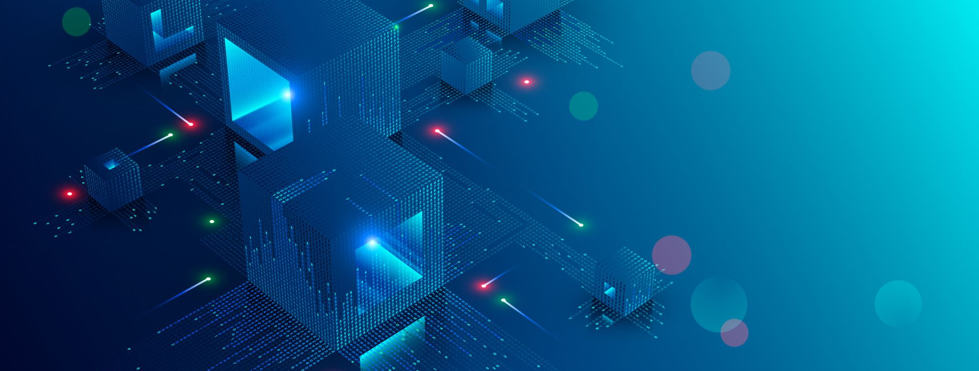
5. Types of Blockchain
Public: Anyone can join (e.g., Bitcoin).
Private: Limited to certain people (used by companies).
Hybrid/Consortium: A mix of public and private systems.

Slide 7
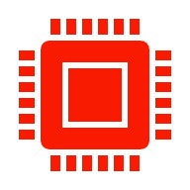
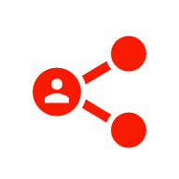

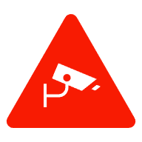
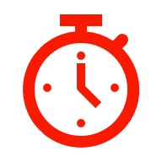
6. Benefits
Security:Data is encrypted and stored across many computers, making it very hard to hack or change.
Transparency:Everyone in the network can see transactions, which builds trust.
No Middlemen:Transactions happen directly between people or organizations, saving time and money.
Immutability:Once data is recorded, it cannot be altered — ensuring records stay accurate and reliable.
Efficiency:Processes like payments or record-sharing can happen faster through automation and smart contracts.

Slide 8
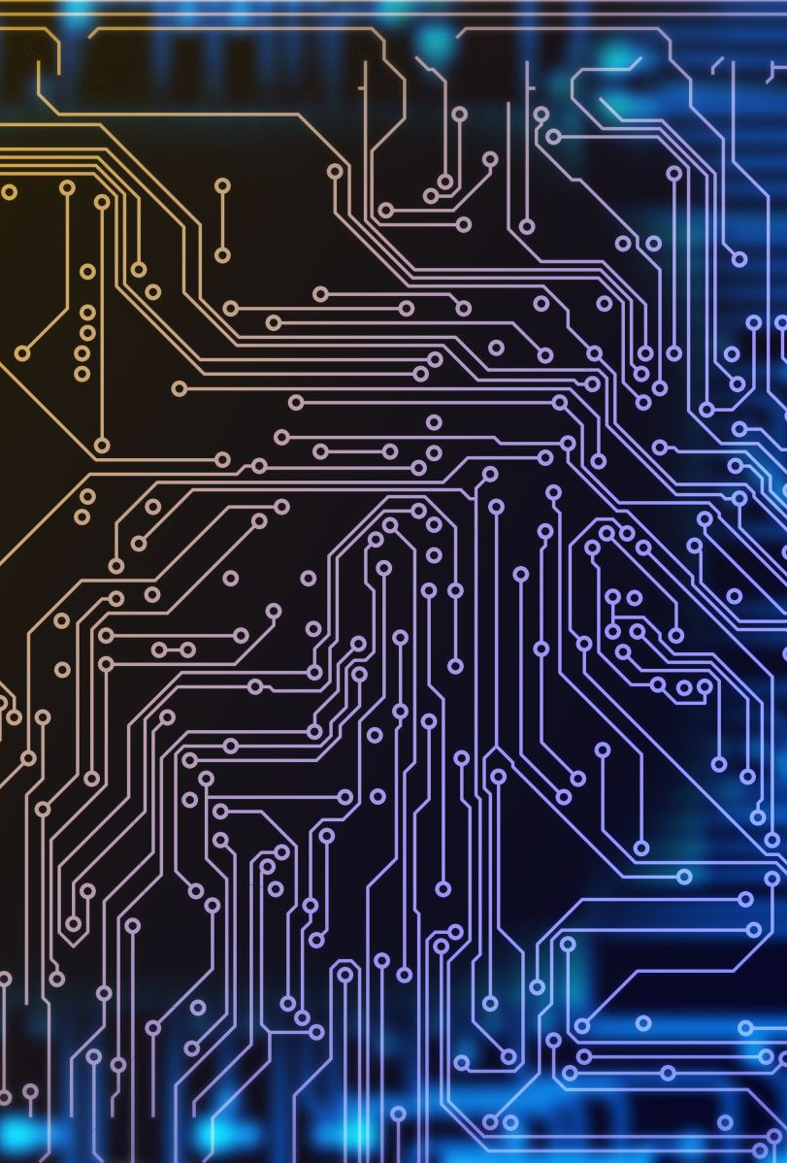
Challenges
1. Energy Use:Some systems (like Bitcoin) require a lot of computing power and electricity.
2. Scalability:When many users join, the network can slow down or become costly to maintain.
3. Regulation:Many governments are still figuring out how to control or monitor blockchain activities.
4. Complexity:The technology is hard to understand and use for beginners or non-technical users.
5.Data Privacy:While transparent, it can be difficult to balance openness with the need to protect sensitive information.

Slide 9

Future and Ethics
1. How might blockchain change how businesses or governments work in the future?
2.What ethical or privacy issues could arise from using blockchain?

Slide 10
Conclusion
Blockchain is changing how people store, share, and trust information.
It removes the need for middlemen, protects against fraud, and builds a new level of transparency across industries.
Although there are still challenges like energy use and regulation blockchain continues to grow as one of the most powerful and secure technologies shaping the future of finance, healthcare, and digital systems.

Slide 11
Learning Assessment Question 1
What is the main purpose of blockchain technology?
a) To store information in one central location
b) To create a secure and shared record of transactions
c) To hide all financial data from the public
d) To replace the internet completely

Slide 12
Question 2
Why is blockchain often called “decentralized”?
a) Because it’s managed by a single organization
b) Because data is stored across many computers
c) Because it has no users
d) Because it cannot be accessed online

Slide 13
Question 3
What connects one block to another in a blockchain?
a) A password
b) A link code
c) A cryptographic hash
d) A transaction ID

Slide 14
Question 4
Why is blockchain considered secure?
a) Because only one user can edit it
b) Because it uses cryptography to protect data
c) Because it is disconnected from the internet
d) Because it deletes old records

Slide 15
Question 5
Which of these is an example of blockchain use?
a) Online shopping carts
b) Cryptocurrency like Bitcoin
c) Text messaging apps
d) File compression software

